Slide 1
ONLION BOOK STORE
LRG GOVERNMENT ARTS COLLEGE FOR WOMEN
JUFRIYA HASHLIN.H ,III yr BSC (COMPUTER SCIENCE) SHIFT 1
Guide: Ms.SUGANTHI MSc..M.phil..

Slide 2
ABSTRACT
The main goal of this project is that we can purchase and read a books in online, we can use this project anywhere whether it’s an download or purchase. When we need to reading a books in online we just search it on google and purchase it. But this software actually working on download the books as free, A administrator login the software and upload the book details and upload the book as well, then user create an user account and login and download book details whether they need, it’s an actually user purpose.

Slide 3
OBJECTIVE
It aims at improving the efficiency in the Issue of books or magazines and reduces the complexities involved in it to the maximum possible extent. If the entire process of ‘Issue of Books or Magazines’ is done in a manual manner then it would take several months for the books or magazines to reach the applicant.

Slide 4
SYSTEM SPECIFICATION
HARDWARE SPECIFICATION:
Processor : P 4 700 GHz.
RAM : 4 GB RAM
Hard Disk Drive : 180 GB
SOFTWARE SPECIFICATION:
Operating System : Windows 7/8/10
Front End : JAVA
Back End : ORACLE

Slide 5
EXISTING SYSTEM
Previously when user need to reading a booking normally go to refer some website and update their knowledge. This is an not a standard way for reading a book reader. It doesn’t give an perfect searching algorithm. Usually the book reader searching a book then the referring sit giving a lot of option to the user. It may the can get confusing when searching a book. It took take too much time to finding a single book. So this software may helps to resolving a issue.

Slide 6
DISADVANTAGES
Take too much time for searching a book
It doesn’t provide pay books
It may not giving an specific author book details
It’s not an user friendly

Slide 7
PROPOSED SYSTEM
In this system can be fulfilled the previous system disadvantages. In this system user can easily identify they searched the book by author wise as well. User go to the book store web page and searching a books. Before that an administrator save the book details and upload the book. It may use an lot of benefits.

Slide 8
ADVANTAGES
User can easily identify the book
Download the books
Find author profile
Very user friendly

Slide 9
MODULES
1. User Registration
This module is used before the user has to be login. This will be collect the user information like name, mobile number, email id etc.. The admin can view the all users profile who are all interest to register the account.
2. Book Registration and view module
A book registration module can be main module of this project, an admin can enter the book details and view the book details. If the admin create the book inside the book registration module then the user can find the book and download it.

Slide 10
3. Purchase book
Some books are need to should buy, so when the user need to buy a book they can purchase it. Admin also can easily identify who are all purchase the book. After the purchasing only they can download it.
4. Register Author Details
Before creating a book author details are most important by an user, so the admin has to register the author details then view the author details both user and admin.

Slide 11

DFD Level 0:

Slide 12
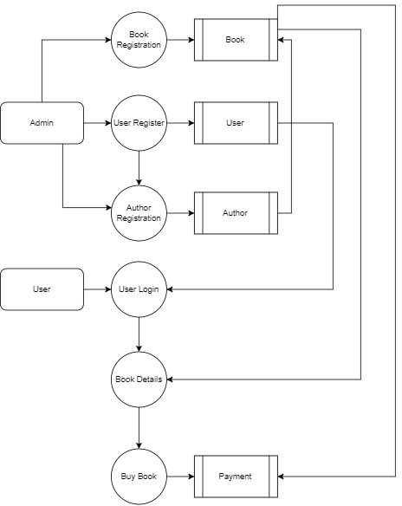
Level 1:

Slide 13
Admin
FIELD | DATA TYPE | SIZE | CONSTRAINT
Admin id | Int | 10 | Primary key
Username | Varchar | 30 | Not null
Password | Varchar | 30 | Not null

Slide 14
Author
FIELD | DATA TYPE | SIZE | CONSTRAINT
Author id | Int | 10 | Primary key
authorname | varchar | 30 | Not null
description | Varchar | 30 | Not null
qualification | varchar | 30 | Not null

Slide 15
Book
FIELD | DATA TYPE | SIZE | CONSTRAINT
Book id | Int | 10 | Primary key
Author id | Int | 10 | Foreign key
Published | Date | 10 | Not null
Book name | Varchar | 30 | Not null
category | varchar | 30 | Not null
subject | varchar | 30 | Not null
price | int | 10 | Not null

Slide 16
Purchase
FIELD | DATA TYPE | SIZE | CONSTRAINT
Purchase id | Int | 10 | Primary key
Book id | Int | 10 | Foreign key
User Id | Int | 10 | Not null
purchase Id | Int | 10 | Not null

Slide 17
User
FIELD | DATA TYPE | SIZE | CONSTRAINT
User id | Int | 10 | Primary key
firstname | Varchar | 30 | Not null
lastname | Varchar | 30 | Not null
mobile | Varchar | 10 | Not null
email | Varchar | 30 | Not null
username | Varchar | 30 | Not null
Password | Varchar | 30 | Not null

Slide 18

Login page

Slide 19
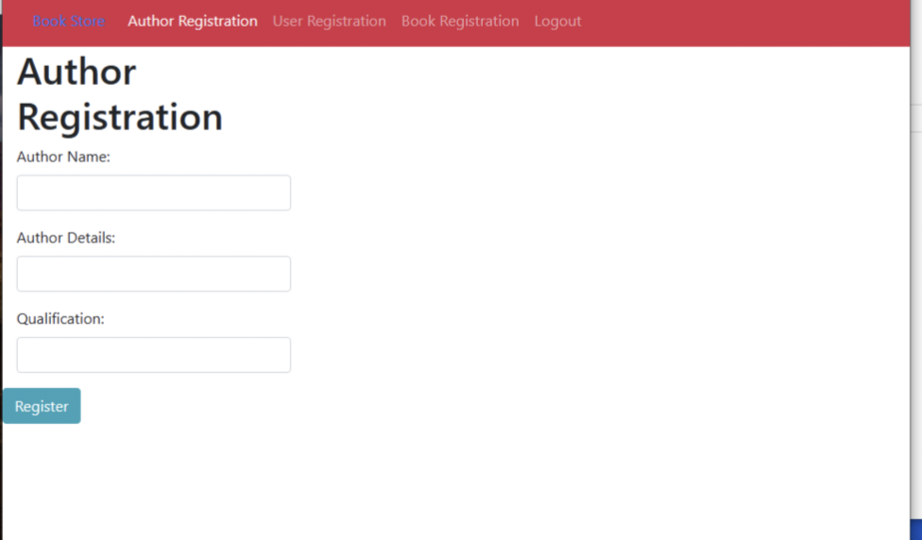
Author Registration

Slide 20
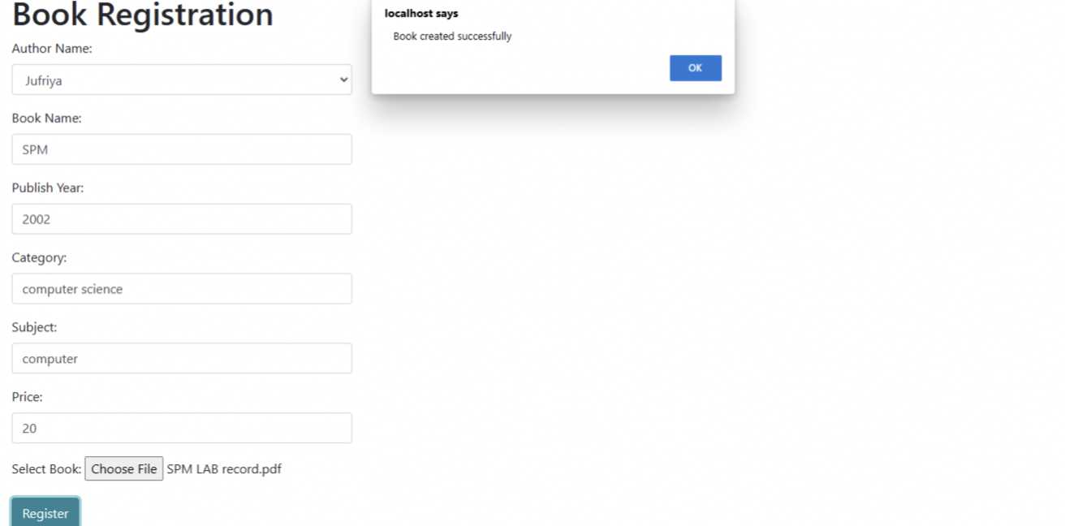
Book Registration

Slide 21
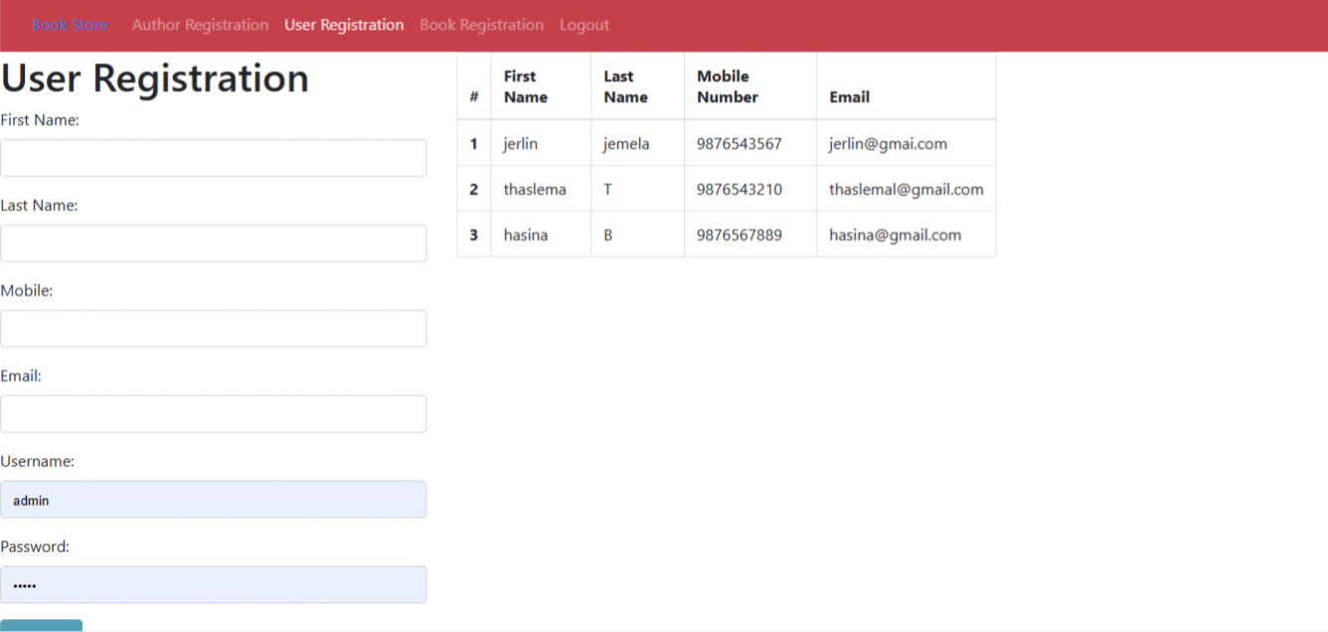
User Registration

Slide 22

Book Details

Slide 23
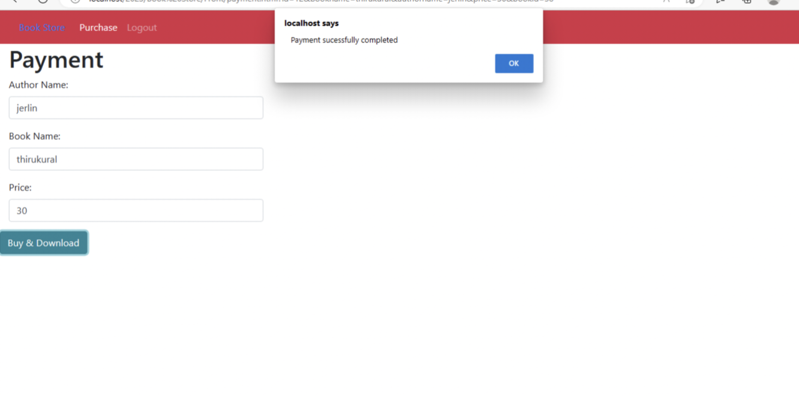
Payment

Slide 24
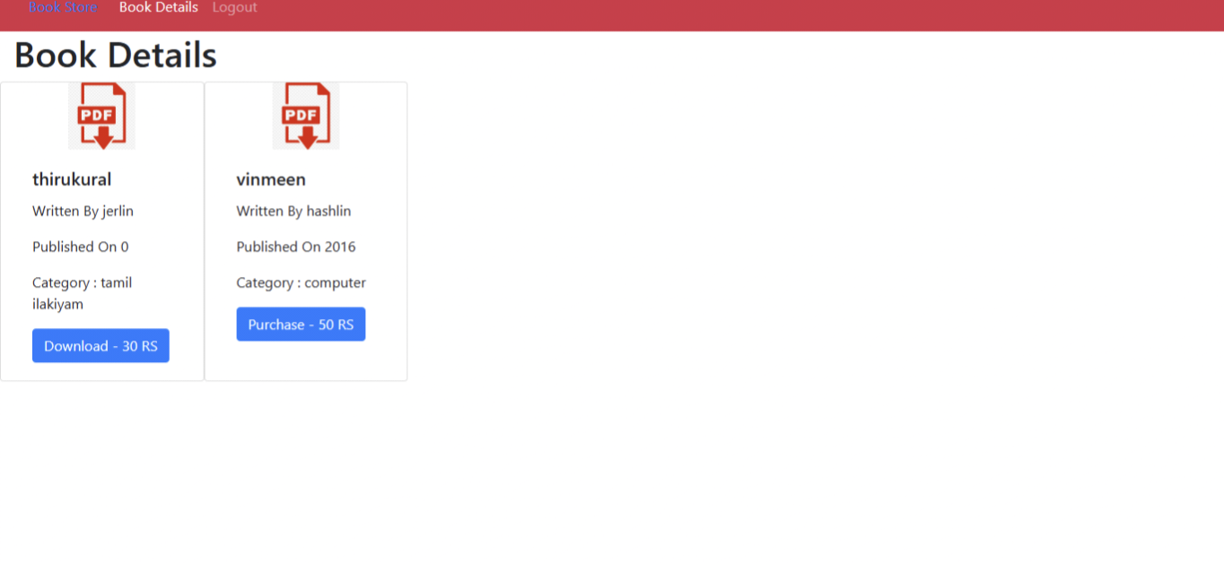
After book purchase

Slide 25
THANK YOU…

